Slide 1


Project Name: Career Path
Finder
Problem Statement :The Challenge of Post-SSLC Stream and Degree Selection
Use Case Explanation Through Conversation
Here's a brief overview of the technology stack involved.

Slide 2
hey ravi congrats u got 97% in ur 10th grade wt next
thanks dear , I dreamed of becoming
User Exbperience (UX) Designer but i don't know wt is the best way to perceive it
ravi recently completed his 10th class and got 97%

Slide 3
sorry ravi i also don't know much about that field .
ha ! in our family and friends also nobody know much about this ...

Slide 4
hey ravi i know a website which can help you with this
website really ?

Slide 5

explore career options
u asked about all the ways to become User Experience (UX) Designer
know?
yes
what next after
find all ways to ur dreams

Slide 6
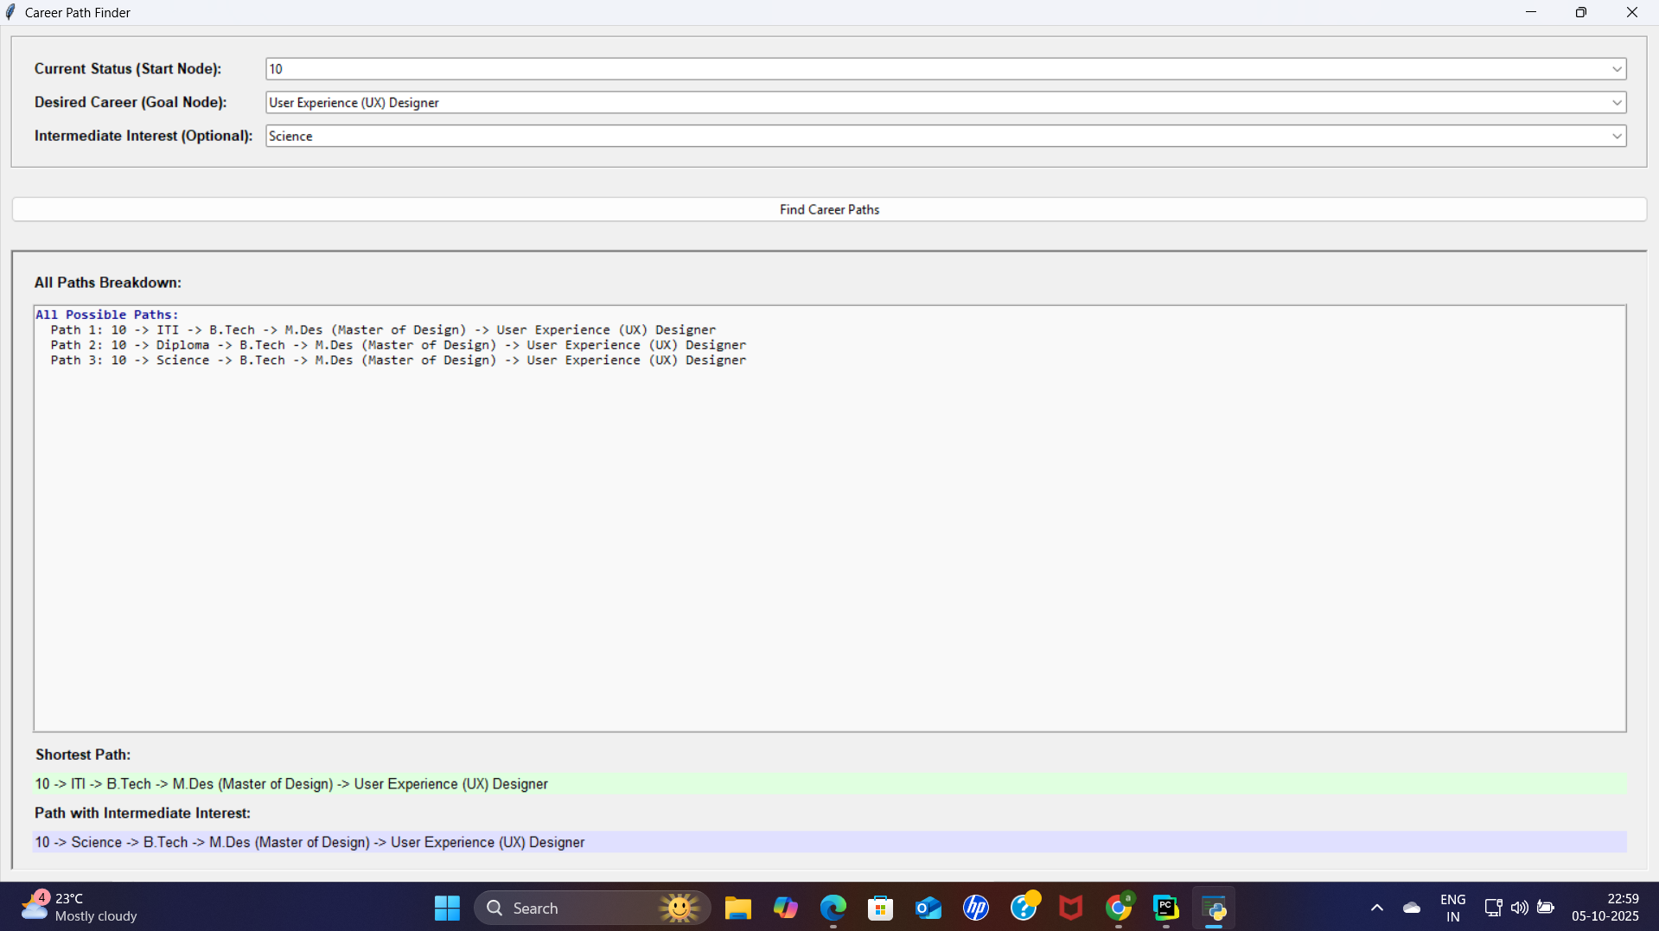
oo super dear super now i can go with diploma as i am very bad in bio
here u go
1st feature

Slide 7
u can also check out the shortest path and path with your interests
yeah
1st feature

Slide 8
after this u can go this one of this path and explore mare about that
What exactly?
1st feature

Slide 9
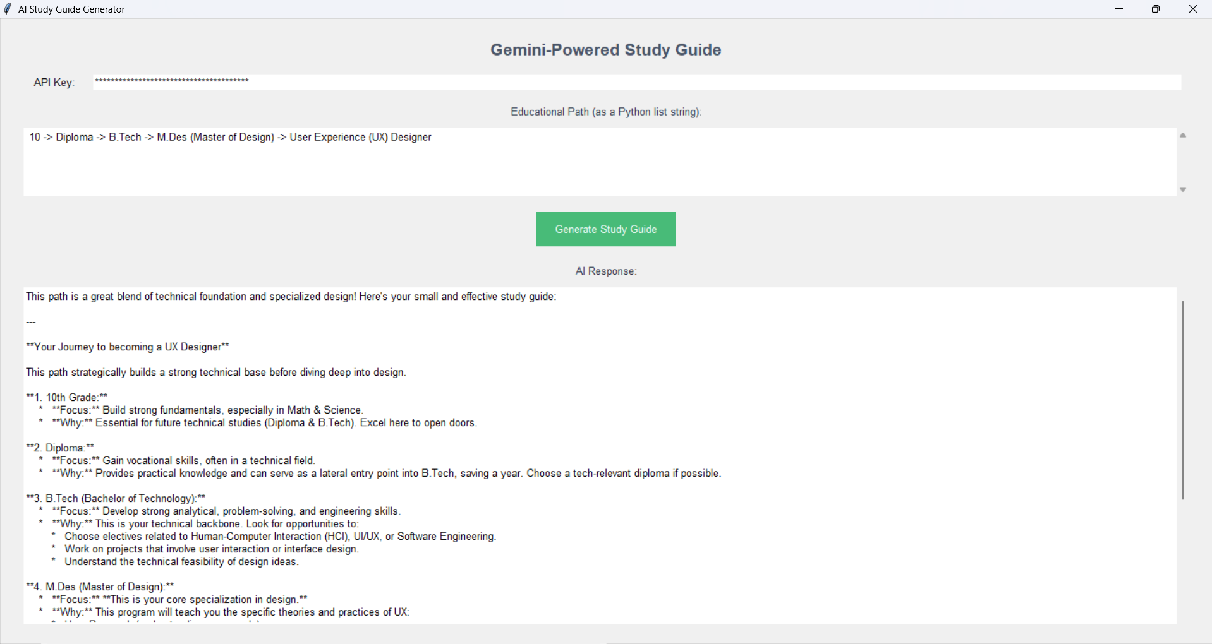
u can get information about all the degree and sub u need to study
ya bro this is a life saver website thanks dear ,
it is very helpful for me
2nd feature

Slide 10
explore career options
not only this if you stuck in-between and u want to explore other available options at certain time u can do that
oh that will be great
what next after
find all ways to ur dreams

Slide 11
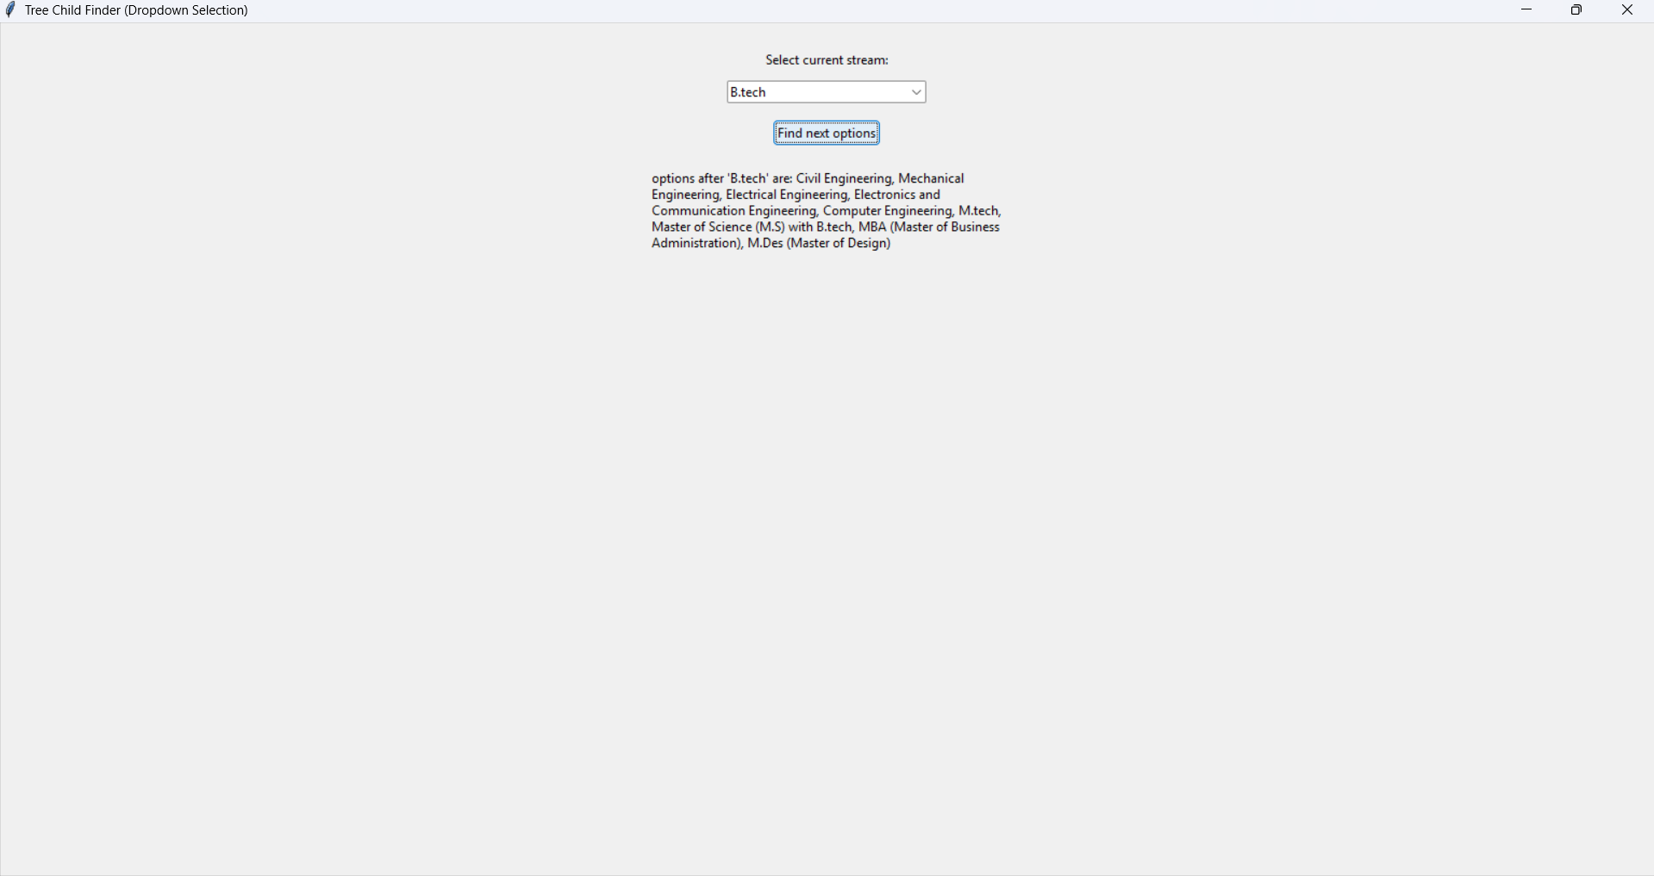
it amazing website ,thanks for thanks for letting me know about this I'll tell my friends also it will help them also
just like this
3rd feature

